Slide 1
Lecture 8a: Regularization

Slide 2
ANNOUNCEMENTS
Religious Holidays: please contact if this affects your HW due dates.
For 209 students:
please submit 209 HW separately from 109 HW in different assignments on Canvas.
A-sec this week: optional to cover 2nd part from last week (Bayesian perspective).

Slide 3
ANNOUNCEMENTS
Milestone 1: Due this Friday, Oct 4 (see Canvas instructions).
Study break: Wednesday 6-8pm in TBD?
Recall Course Requirements: “You are expected to have programming experience at the level of CS 50 or above, and statistics knowledge at the level of Stat 100 or above (Stat 110 recommended).”

Slide 5
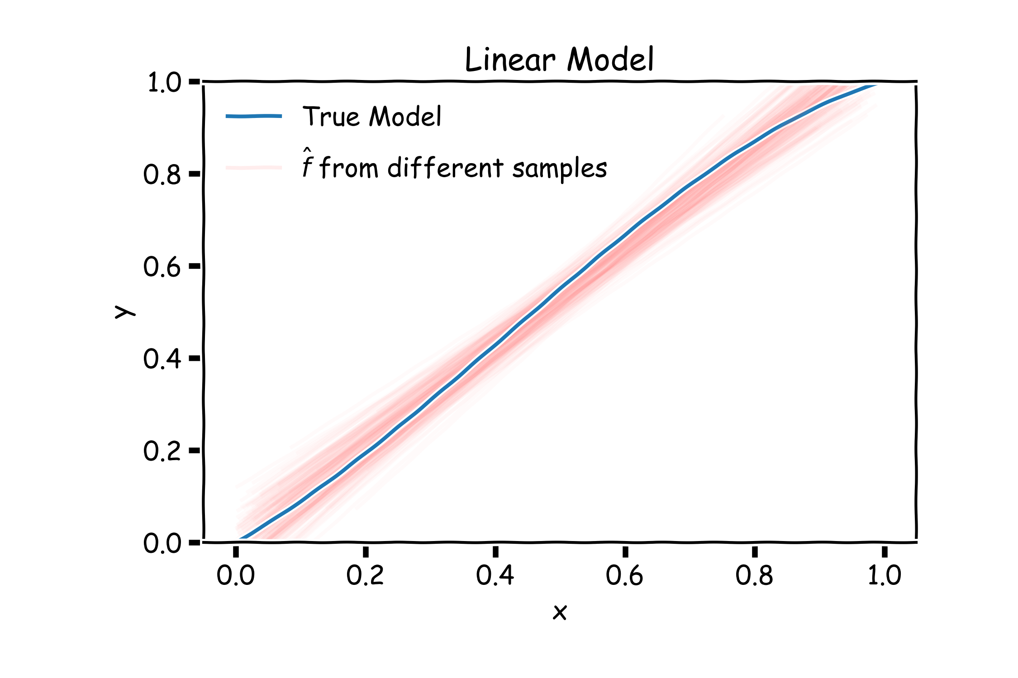
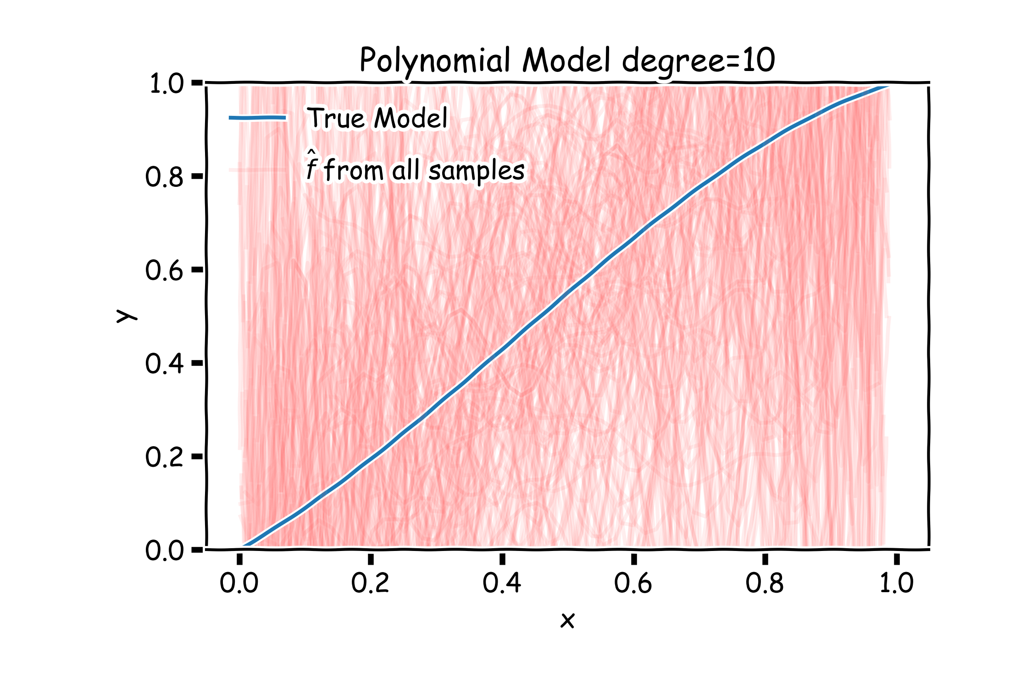
Bias vs Variance
Left: 2000 best fit straight lines, each fitted on a different 20 point training set.
Right: Best-fit models using degree 10 polynomial

Slide 6
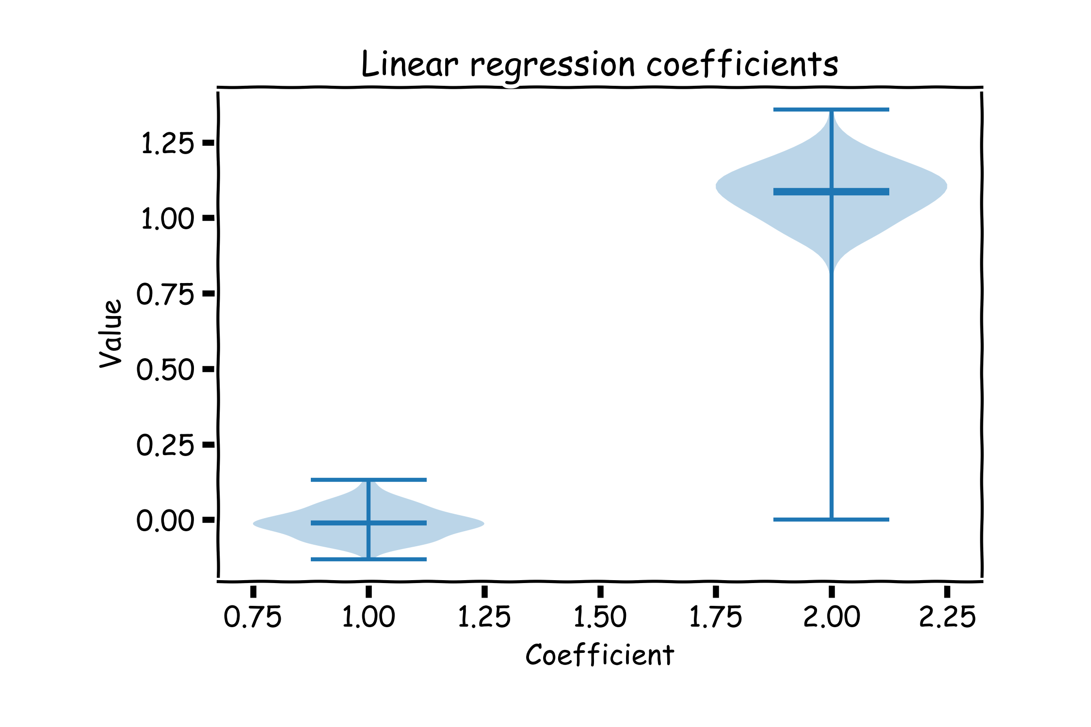
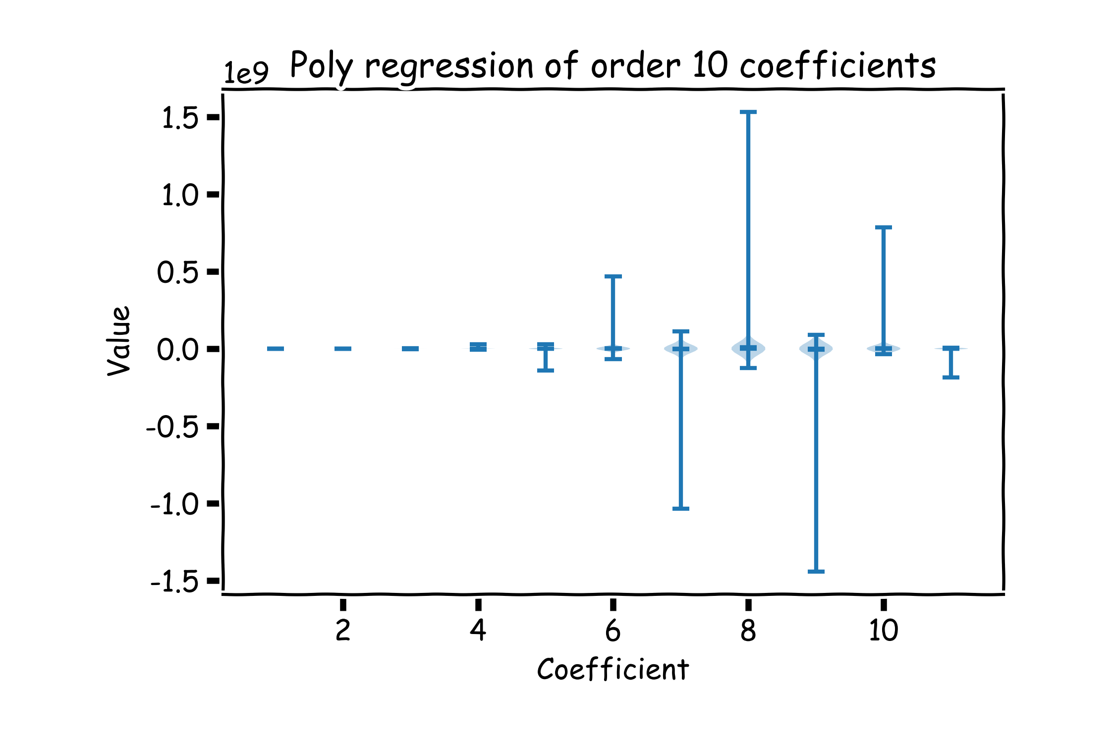
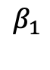
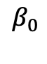
Bias vs Variance
Left: Linear regression coefficients
Right: Poly regression of order 10 coefficients
$$β_{0}$$
$$β_{1}$$

Slide 7
Lecture Outline
Regularization: LASSO and Ridge
Geometric Interpretation

Slide 8
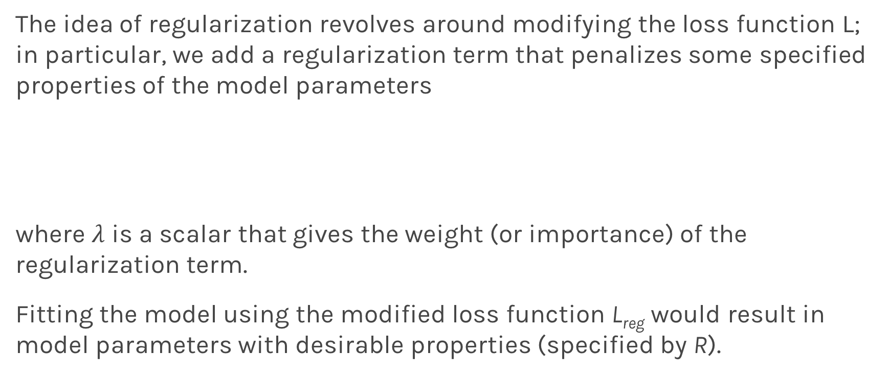
Regularization: An Overview
The idea of regularization revolves around modifying the loss function L; in particular, we add a regularization term that penalizes some specified properties of the model parameters
where $λ$ is a scalar that gives the weight (or importance) of the regularization term.
Fitting the model using the modified loss function L_{reg} would result in model parameters with desirable properties (specified by R).

Slide 9
LASSO Regression
Since we wish to discourage extreme values in model parameter, we need to choose a regularization term that penalizes parameter magnitudes. For our loss function, we will again use MSE.
Together our regularized loss function is:
Note that is the l₁ norm of the vector β

Slide 10
Ridge Regression
Alternatively, we can choose a regularization term that penalizes the squares of the parameter magnitudes. Then, our regularized loss function is:
Note that is the square of the l₂ norm of the vector β

Slide 11
Choosing λ
In both ridge and LASSO regression, we see that the larger our choice of the regularization parameter λ, the more heavily we penalize large values in β,
If λ is close to zero, we recover the MSE, i.e. ridge and LASSO regression is just ordinary regression.
If λ is sufficiently large, the MSE term in the regularized loss function will be insignificant and the regularization term will force β_{ridge} and β_{LASSO} to be close to zero.
To avoid ad-hoc choices, we should select λ using cross-validation.

Slide 12
Ridge, LASSO - Computational complexity
Solution to ridge regression:
The solution to the LASSO regression:
LASSO has no conventional analytical solution, as the L1 norm has no derivative at 0. We can, however, use the concept of subdifferential or subgradient to find a manageable expression. See a–sec2 for details.

Slide 13
Regularization Parameter with a Validation Seet
The solution of the Ridge/Lasso regression involves three steps:
Select λ
Find the minimum of the ridge/Lasso regression loss function (using the formula for ridge) and record the MSE on the validation set.
Find the λ that gives the smallest MSE

Slide 14
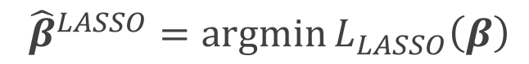
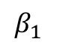
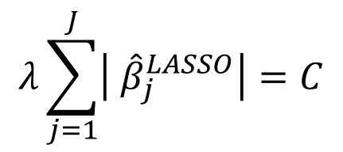

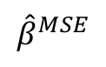
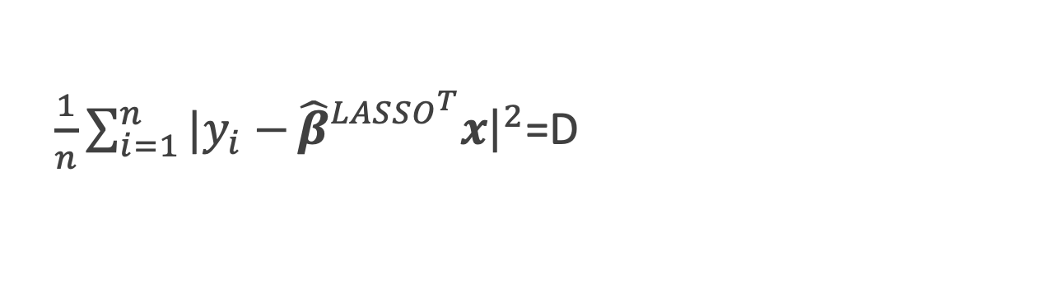
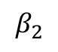
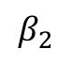
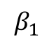
The Geometry of Regularization (LASSO)
$$L_{LASSO}\left(β\right)=\frac{1}{n}\sum_{i=1}^{n}{|y_{i}−}β^{T}x{\left.​\right|}^{2}+λ\sum_{j=1}^{J}{|β_{j}|}$$
$${\hat{β}}^{LASSO}=argmin{L_{LASSO}\left(β\right)}$$
$\frac{1}{n}\sum_{i=1}^{n}{|y_{i}−}{\hat{β}}_{}^{LASSO^{T}}x{\left.​\right|}^{2}$=D
$$λ\sum_{j=1}^{J}{\left| {\hat{β}}_{j}^{LASSO}\right|=C}$$
$$β_{2}$$
$$β_{2}$$
C
$${\hat{β}}^{MSE}$$
MSE=D
C
$$β_{1}$$
$$β_{1}$$

Slide 15
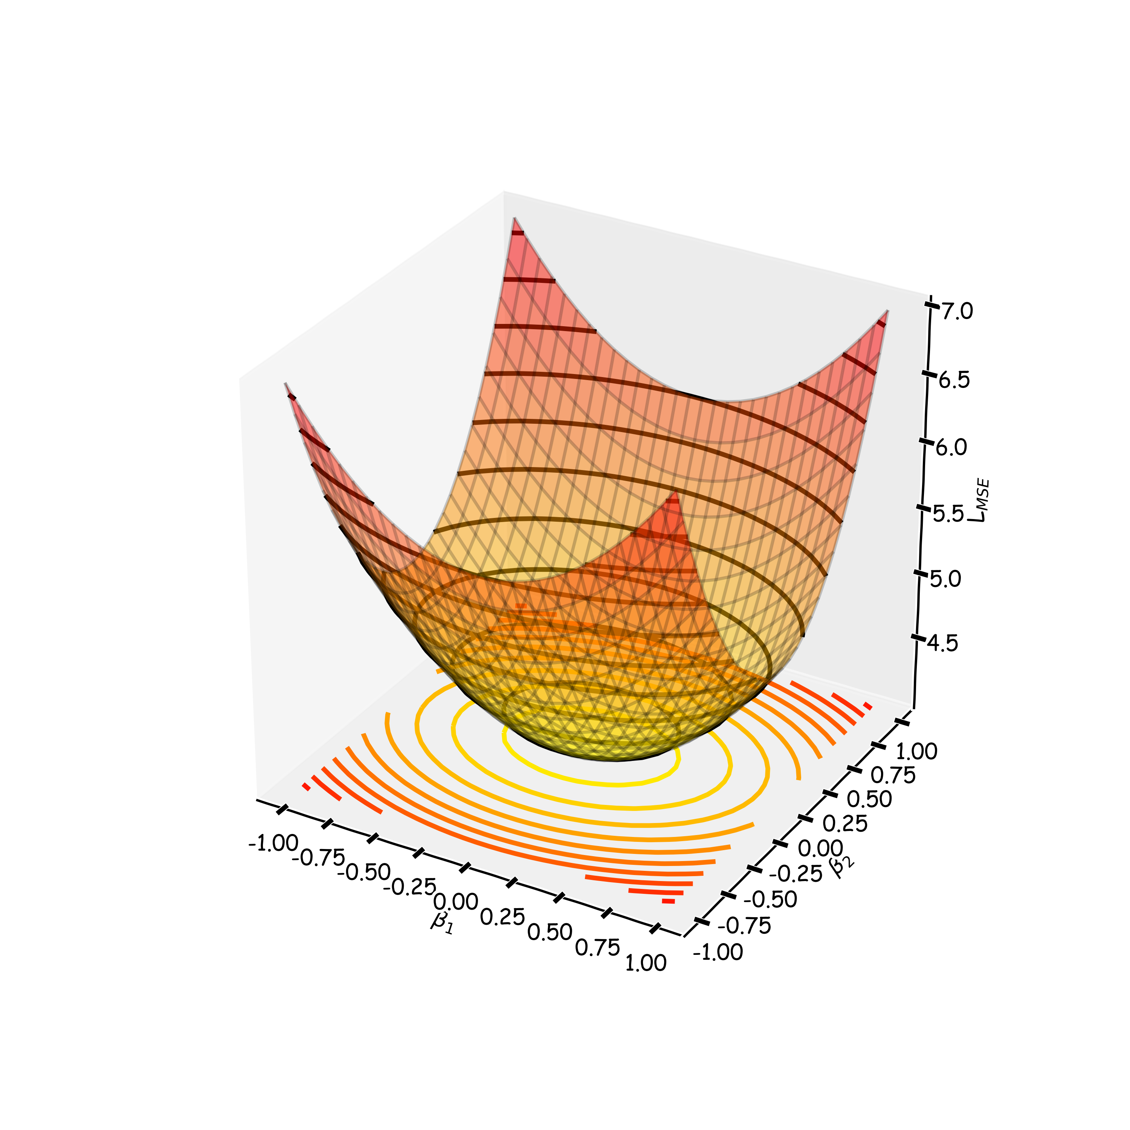
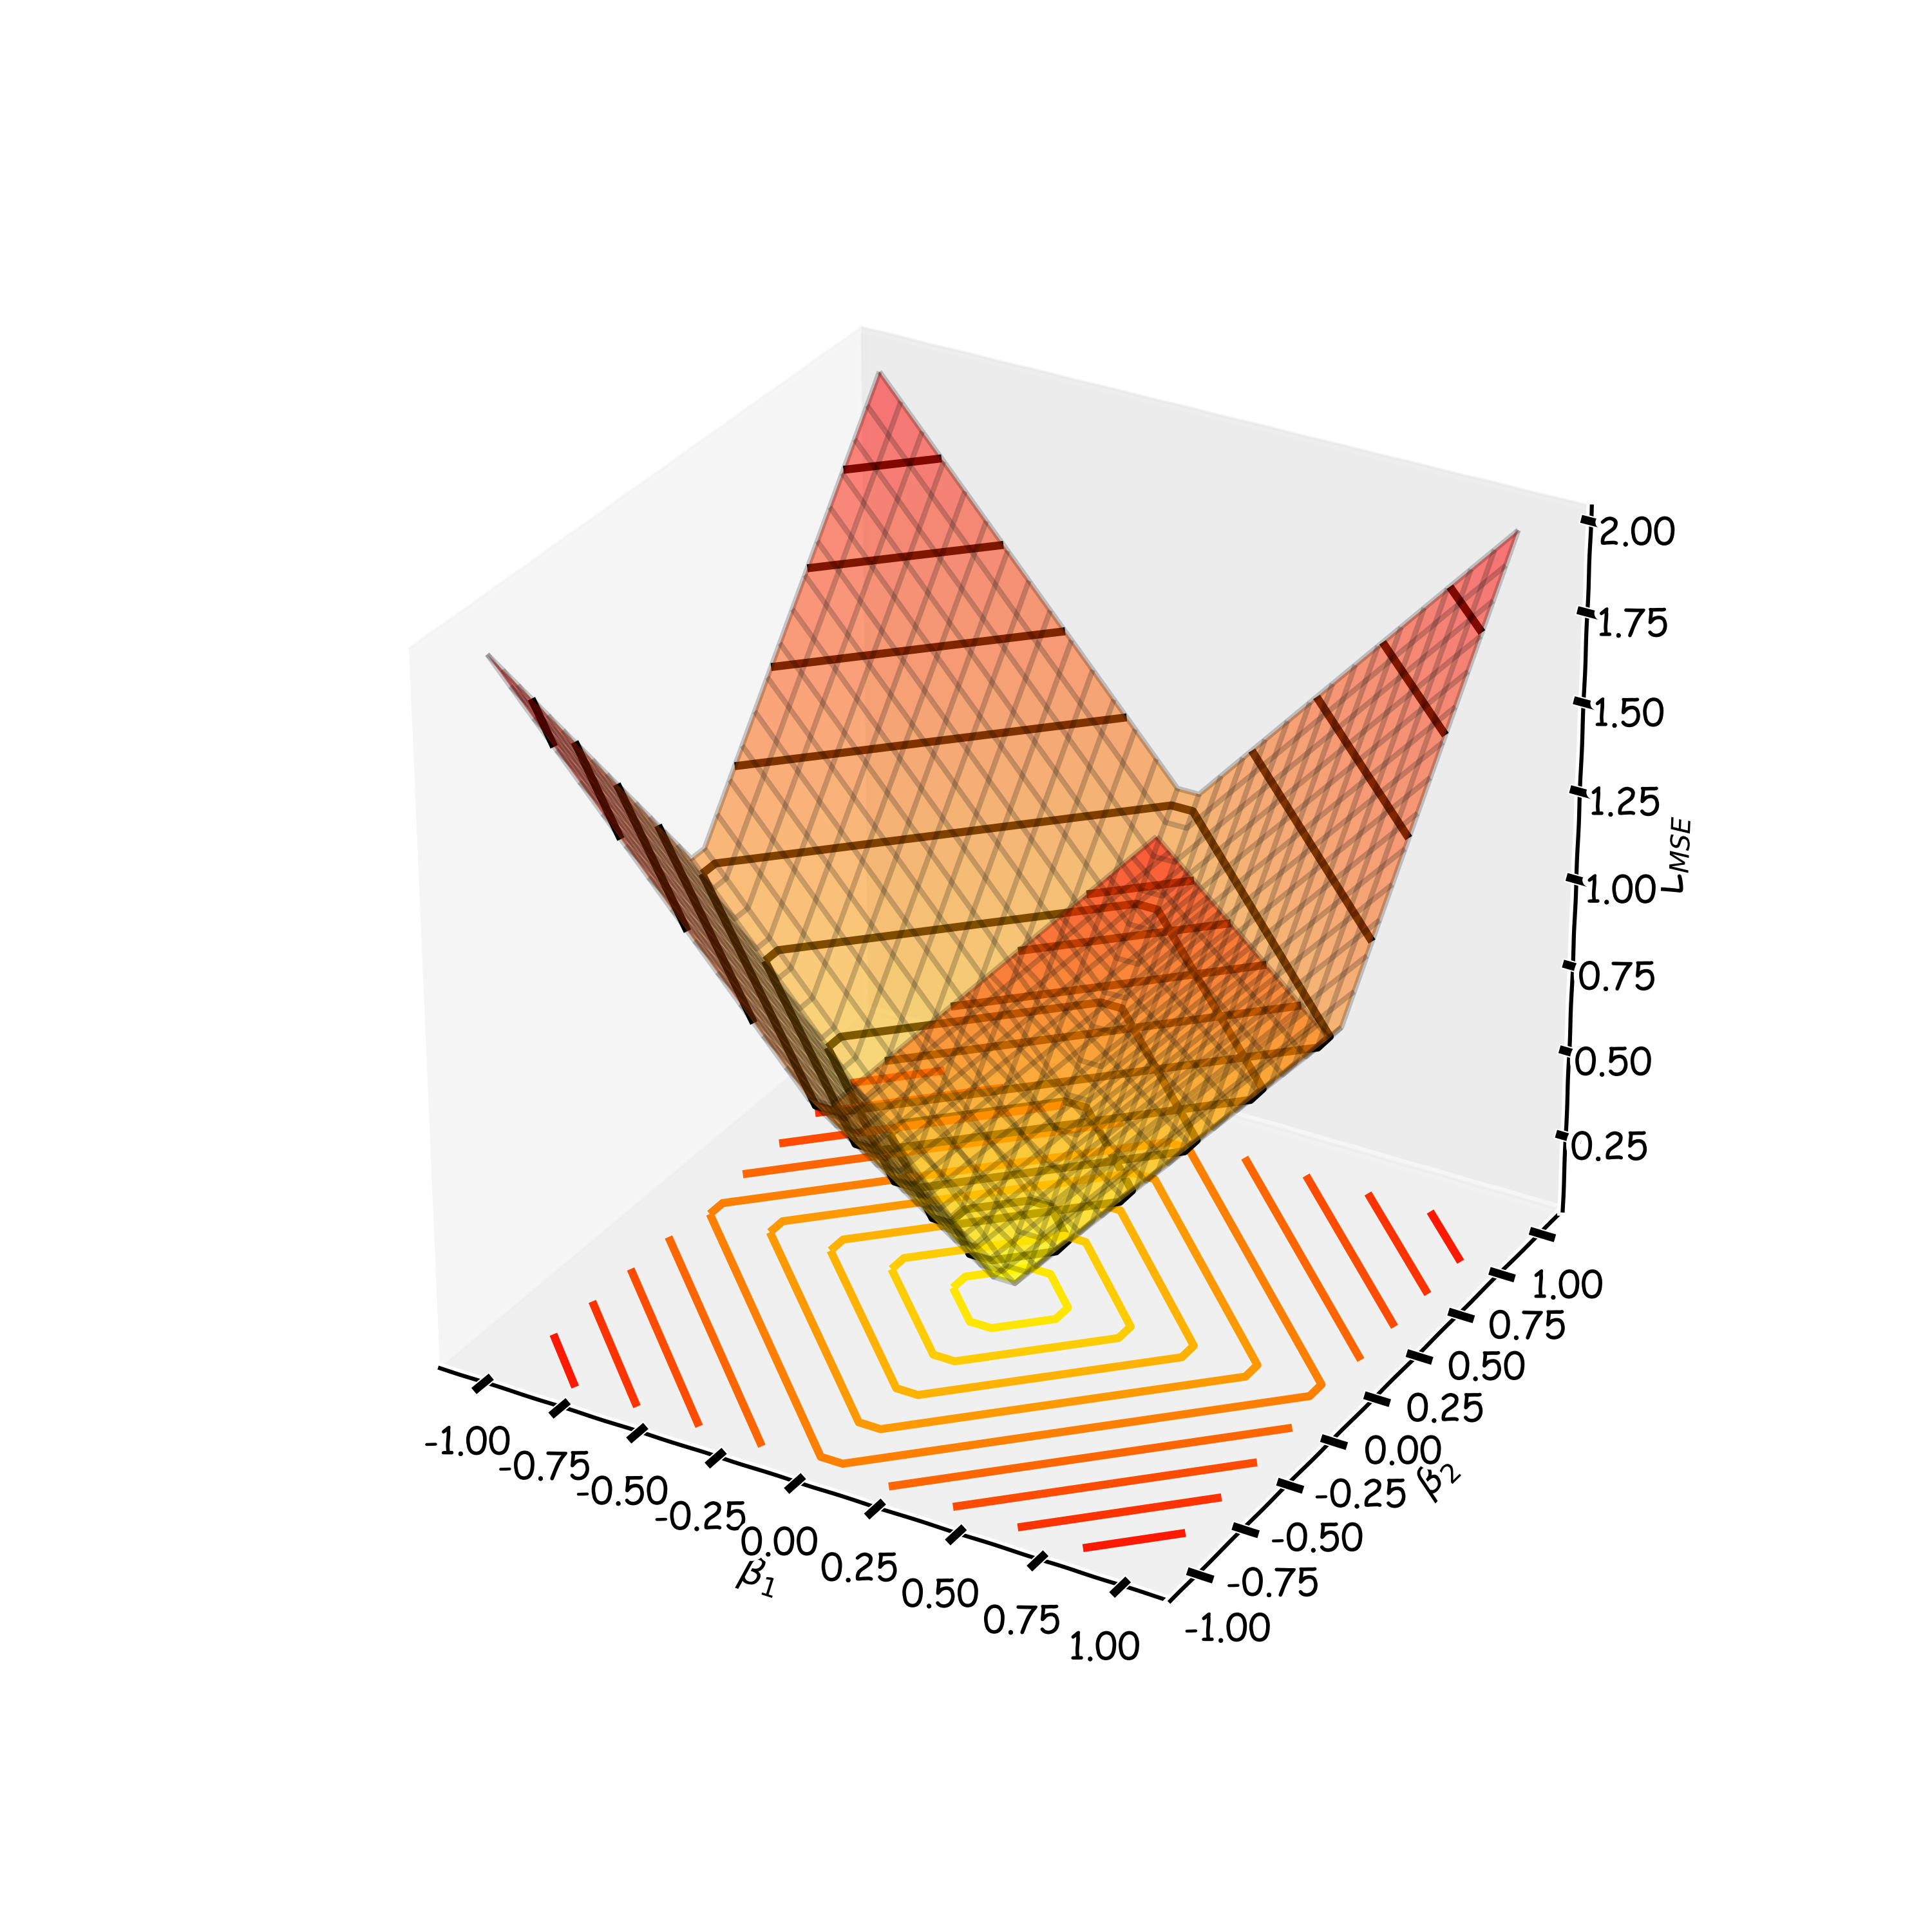
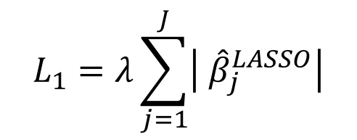

The Geometry of Regularization (LASSO)
$$L_{LASSO}\left(β\right)=\frac{1}{n}\sum_{i=1}^{n}{|y_{i}−}β^{T}x{\left.​\right|}^{2}+λ\sum_{j=1}^{J}{|β_{j}|}$$
$${\hat{β}}^{LASSO}=argmin{L_{LASSO}\left(β\right)}$$
$$L_{1}=λ\sum_{j=1}^{J}{\left| {\hat{β}}_{j}^{LASSO}\right|}$$
$$L_{MSE}\left(β\right)=\frac{1}{n}\sum_{i=1}^{n}{|y_{i}−}β^{T}x{\left.​\right|}^{2}$$

Slide 16
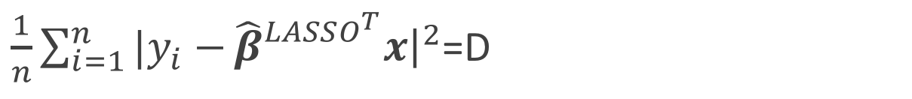
The Geometry of Regularization (LASSO)
$$L_{LASSO}\left(β\right)=\frac{1}{n}\sum_{i=1}^{n}{|y_{i}−}β^{T}x{\left.​\right|}^{2}+λ\sum_{j=1}^{J}{|β_{j}|}$$
$${\hat{β}}^{LASSO}=argmin{L_{LASSO}\left(β\right)}$$
$$λ\sum_{j=1}^{J}{\left| {\hat{β}}_{j}^{LASSO}\right|=C}$$
$\frac{1}{n}\sum_{i=1}^{n}{|y_{i}−}{\hat{β}}_{}^{LASSO^{T}}x{\left.​\right|}^{2}$=D
$$β_{2}$$
$$β_{2}$$
C
$${\hat{β}}^{MSE}$$
MSE=D
C
$$β_{1}$$
$$β_{1}$$

Slide 17
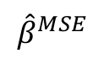
The Geometry of Regularization (LASSO)
$$β_{2}$$
$$β_{2}$$
$$β_{2}$$
$${\hat{β}}^{MSE}$$
MSE=D
C
C
$${\hat{β}}^{MSE}$$
MSE=D
C
C
$$β_{1}$$
$$β_{1}$$
$$β_{1}$$

Slide 18
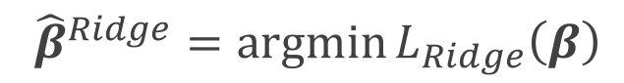

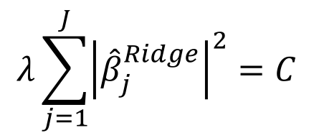
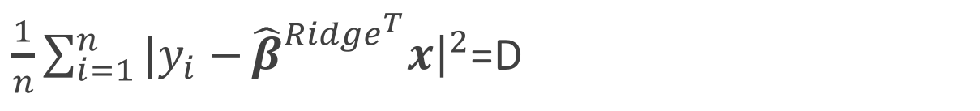
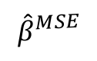
The Geometry of Regularization (Ridge)
$$L_{Ridge}\left(β\right)=\frac{1}{n}\sum_{i=1}^{n}{|y_{i}−}β^{T}x{\left.​\right|}^{2}+λ\sum_{j=1}^{J}{{\left(β_{j}\right)}^{2}}$$
$${\hat{β}}^{Ridge}=argmin{L_{Ridge}\left(β\right)}$$
$$λ\sum_{j=1}^{J}{{\left|{\hat{β}}_{j}^{Ridge}\right|}^{2}=C}$$
$\frac{1}{n}\sum_{i=1}^{n}{|y_{i}−}{\hat{β}}_{}^{{Ridge}^{T}}x{\left.​\right|}^{2}$=D
$$β_{2}$$
$$β_{2}$$
$${\hat{β}}^{MSE}$$
MSE=D
C
$$β_{1}$$
$$β_{1}$$

Slide 19
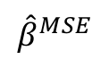
The Geometry of Regularization (Ridge)
$$β_{2}$$
$${\hat{β}}^{MSE}$$
MSE=D
C
$$β_{1}$$

Slide 20
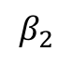
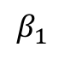
The Geometry of Regularization
$$β_{2}$$
$$β_{2}$$
$${\hat{β}}^{MSE}$$
MSE=D
$${\hat{β}}^{MSE}$$
MSE=D
C
C
C
$$β_{1}$$
$$β_{1}$$

Slide 21
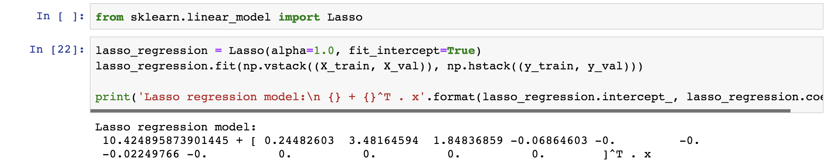
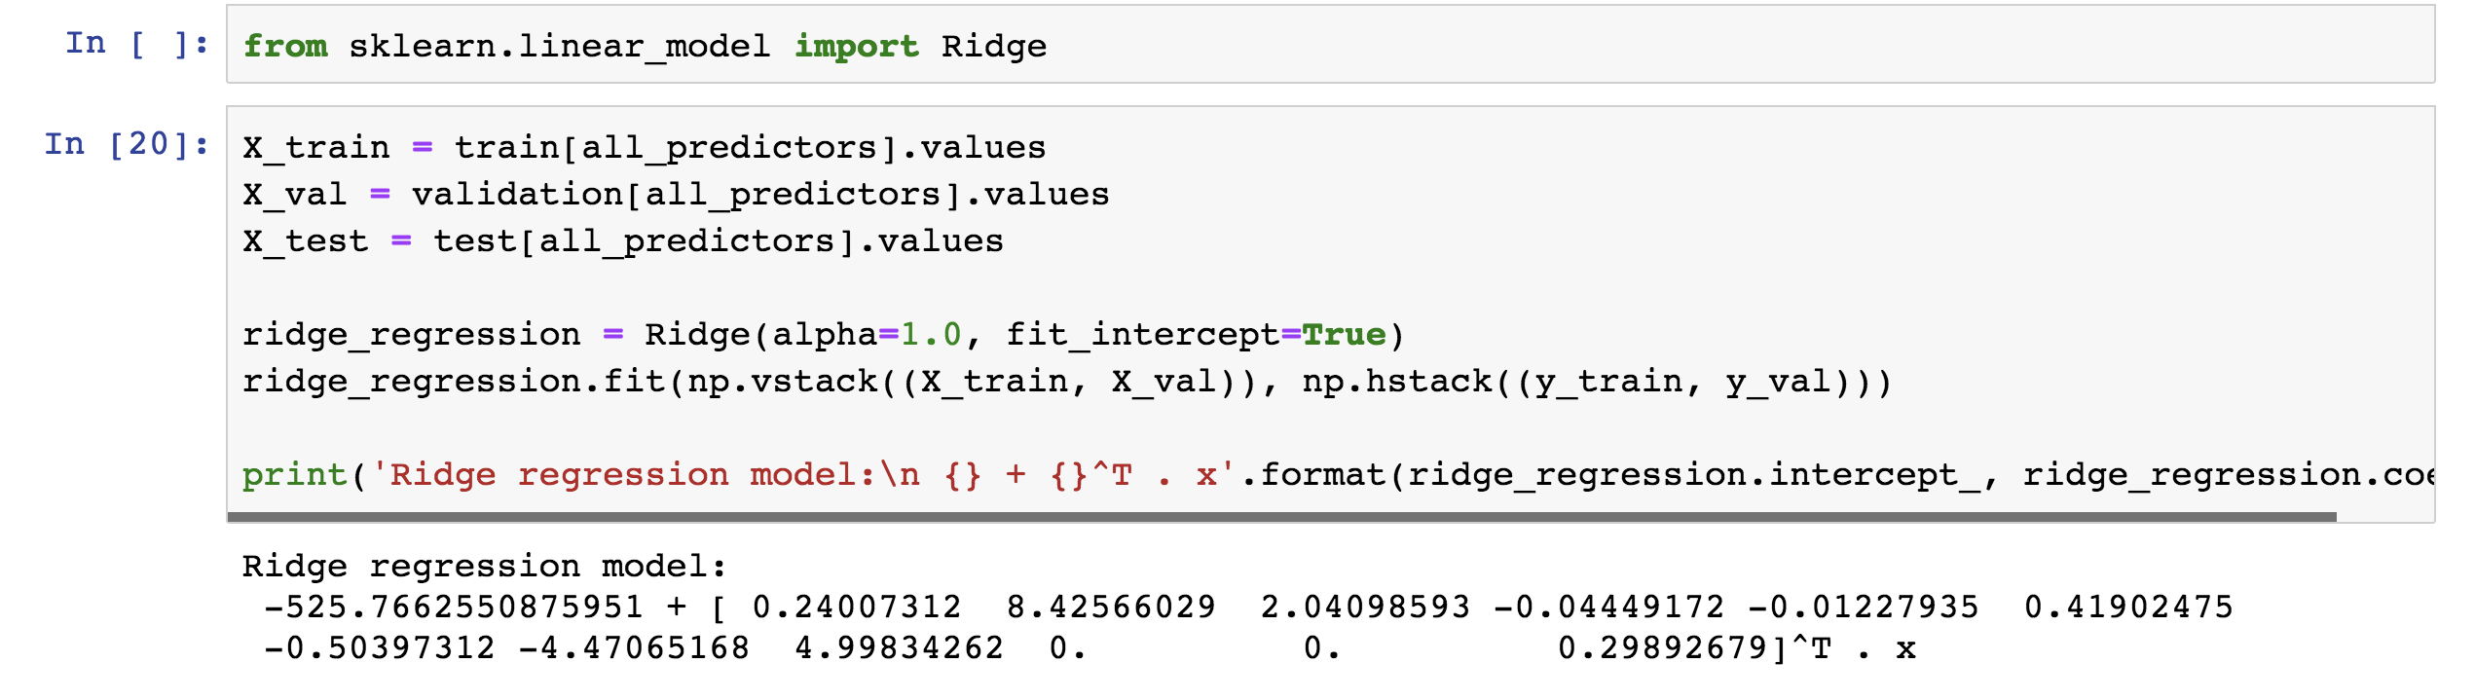
Examples

Slide 22
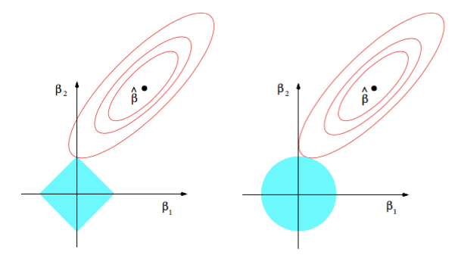
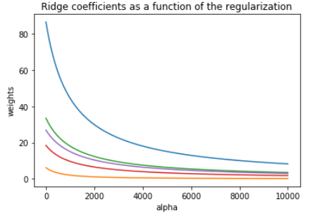
Ridge visualized
Ridge estimator
The ridge estimator is where the constraint and the loss intersect.
The values of the coefficients decrease as lambda increases, but they are not nullified.

Slide 23
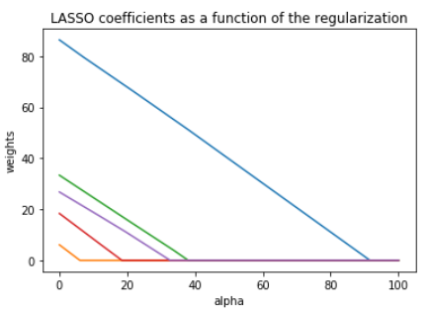
LASSO visualized
Lasso estimator
The Lasso estimator tends to zero out parameters as the OLS loss can easily intersect with the constraint on one of the axis.
The values of the coefficients decrease as lambda increases, and are nullified fast.

Slide 24
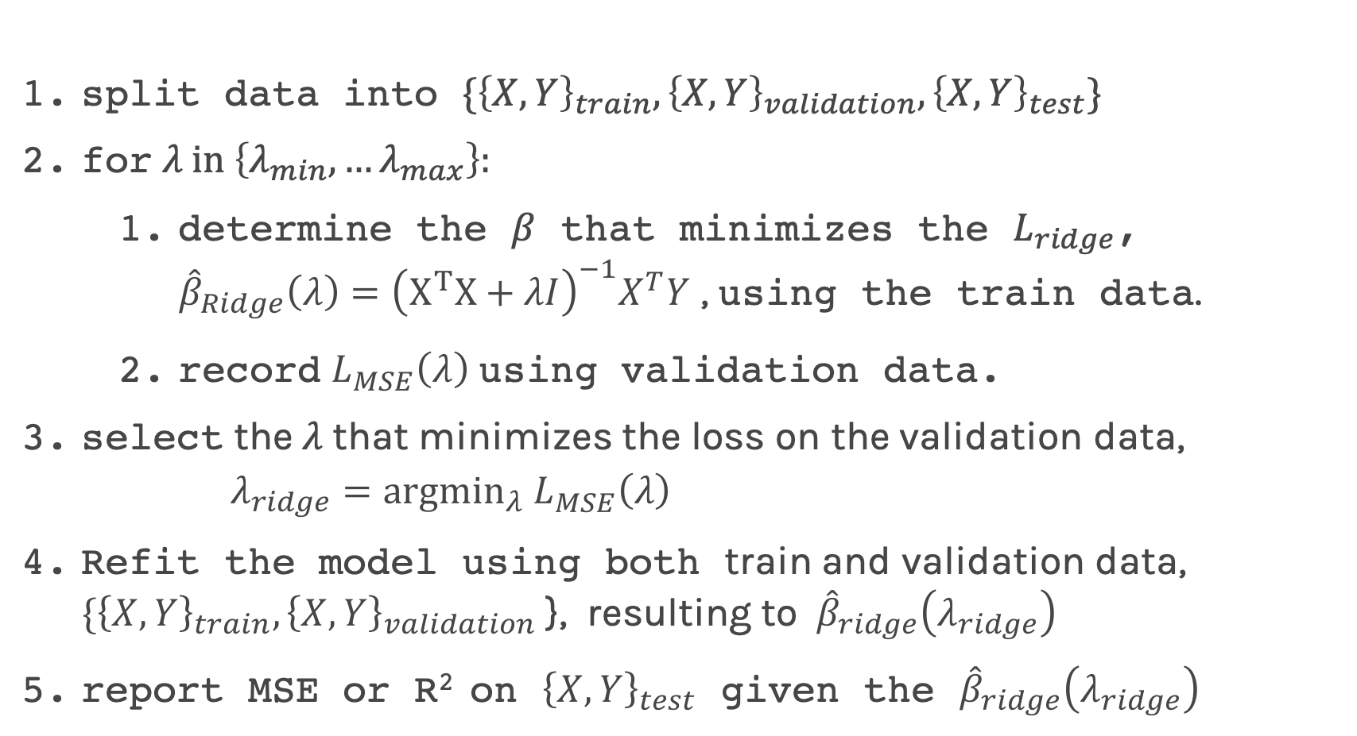
Ridge regularization with only validation : step by step
split data into $\{{\left\{X,Y\right\}}_{train},{\left\{X,Y\right\}}_{validation},{\left\{X,Y\right\}}_{test}\}$
for $λ in \left\{λ_{min},…λ_{max}\right\}:$
determine the $β$ that minimizes the $L_{ridge}$, ${\hat{β}}_{Ridge}\left(λ\right)={\left(X^{T}X+λI\right)}^{−1}X^{T}Y$ , using the train data.
record $L_{MSE}^{}\left(λ\right)$ using validation data.
select the $λ$that minimizes the loss on the validation data, $λ_{ridge}={argmin}_{λ} L_{MSE}^{}\left(λ\right)$
Refit the model using both train and validation data, $\{{\left\{X,Y\right\}}_{train},{\left\{X,Y\right\}}_{validation}$ }, resulting to ${\hat{β}}_{ridge}\left(λ_{ridge}\right)$
report MSE or R² on ${\left\{X,Y\right\}}_{test}$ given the ${\hat{β}}_{ridge}\left(λ_{ridge}\right)$

Slide 25
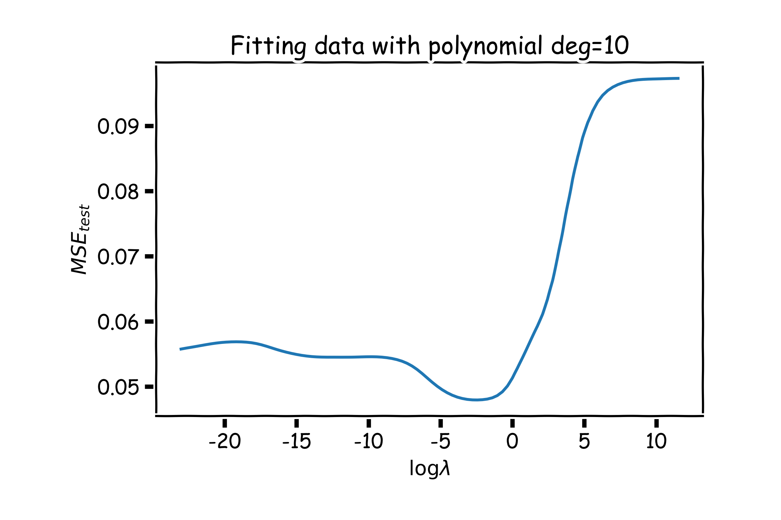
Ridge regularization with validation only: step by step
val

Slide 26
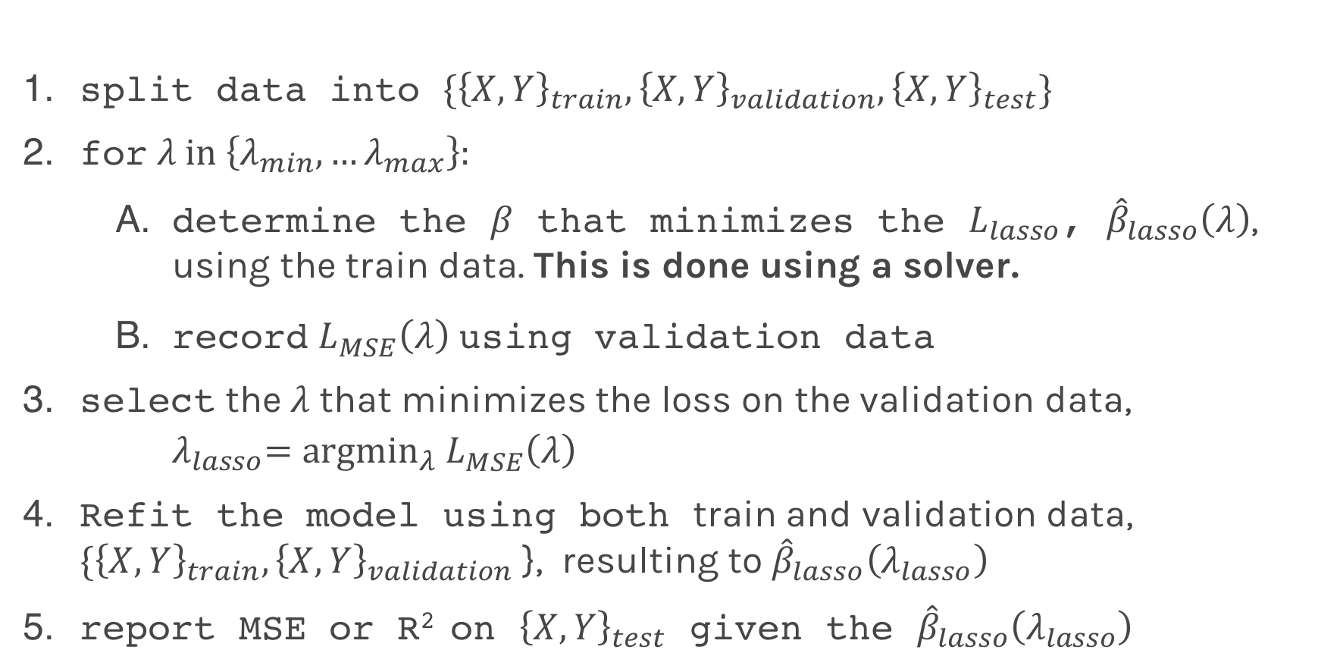
Lasso regularization with validation only: step by step
split data into $\{{\left\{X,Y\right\}}_{train},{\left\{X,Y\right\}}_{validation},{\left\{X,Y\right\}}_{test}\}$
for $λ in \left\{λ_{min},…λ_{max}\right\}:$
determine the $β$ that minimizes the $L_{lasso}$, ${\hat{β}}_{lasso}\left(λ\right)$, using the train data. This is done using a solver.
record $L_{MSE}^{}\left(λ\right)$ using validation data
select the $λ$that minimizes the loss on the validation data, ${ λ}_{lasso}={argmin}_{λ} L_{MSE}^{}\left(λ\right)$
Refit the model using both train and validation data, $\{{\left\{X,Y\right\}}_{train},{\left\{X,Y\right\}}_{validation}$ }, resulting to ${\hat{β}}_{lasso}\left(λ_{lasso}\right)$
report MSE or R² on ${\left\{X,Y\right\}}_{test}$ given the ${\hat{β}}_{lasso}\left(λ_{lasso}\right)$

Slide 27
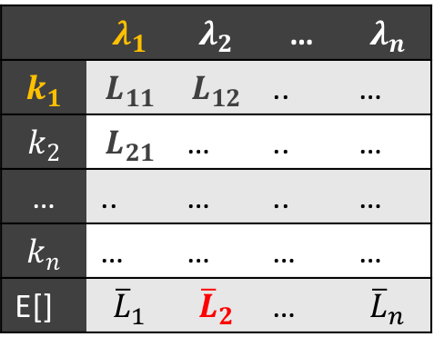
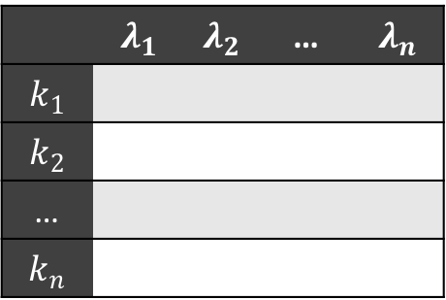
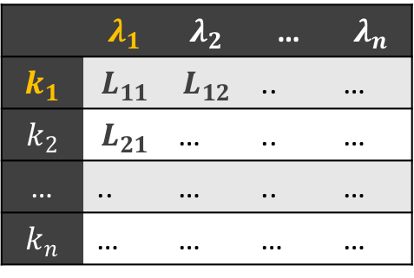
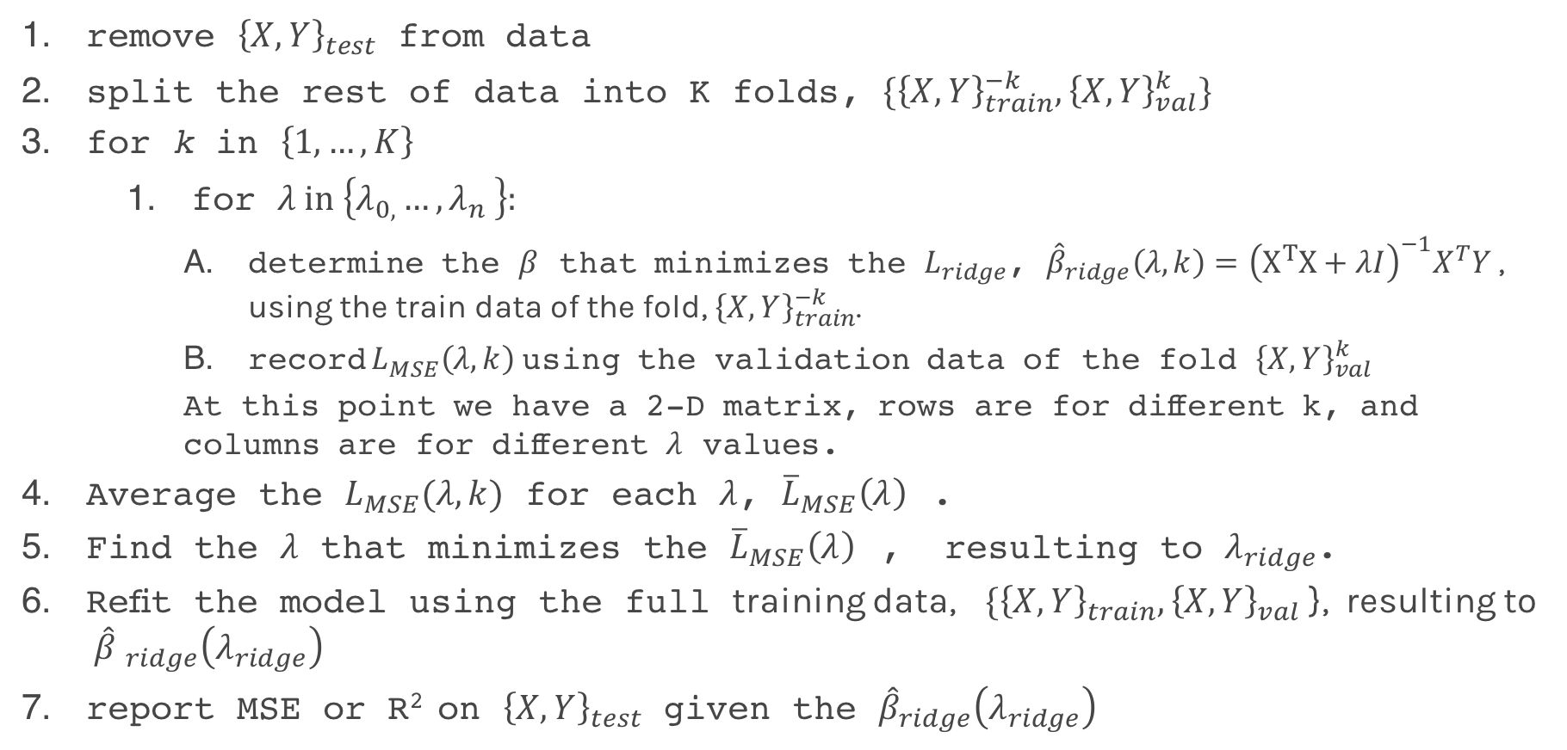
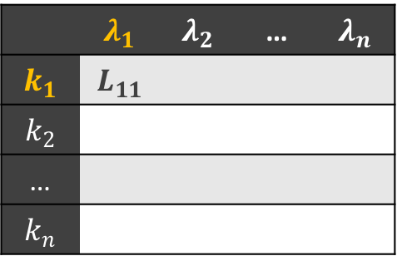
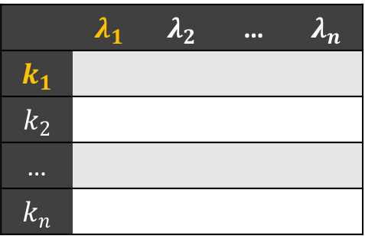
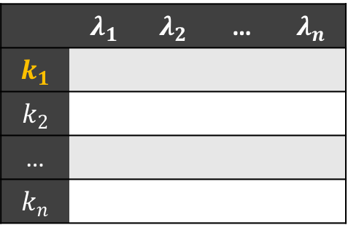
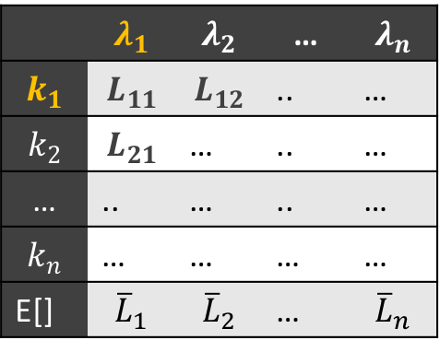
Ridge regularization with CV: step by step
 | $$λ_{1}$$ | $$λ_{2}$$ | … | $$λ_{n}$$
$$k_{1}$$
$$k_{2}$$
…
$$k_{n}$$
 | $$λ_{1}$$ | $$λ_{2}$$ | … | $$λ_{n}$$
$$k_{1}$$ | $$L_{11}$$ | $$L_{12}$$ | .. | …
$$k_{2}$$ | $$L_{21}$$ | … | .. | …
… | .. | … | .. | …
$$k_{n}$$ | … | … | … | …
E[] | $${\overline{L}}_{1}$$ | $${\overline{L}}_{2}$$ | … | $${\overline{L}}_{n}$$
 | $$λ_{1}$$ | $$λ_{2}$$ | … | $$λ_{n}$$
$$k_{1}$$
$$k_{2}$$
…
$$k_{n}$$
 | $$λ_{1}$$ | $$λ_{2}$$ | … | $$λ_{n}$$
$$k_{1}$$ | $$L_{11}$$ | $$L_{12}$$ | .. | …
$$k_{2}$$ | $$L_{21}$$ | … | .. | …
… | .. | … | .. | …
$$k_{n}$$ | … | … | … | …
 | $$λ_{1}$$ | $$λ_{2}$$ | … | $$λ_{n}$$
$$k_{1}$$ | $$L_{11}$$
$$k_{2}$$
…
$$k_{n}$$
 | $$λ_{1}$$ | $$λ_{2}$$ | … | $$λ_{n}$$
$$k_{1}$$ | $$L_{11}$$ | $$L_{12}$$ | .. | …
$$k_{2}$$ | $$L_{21}$$ | … | .. | …
… | .. | … | .. | …
$$k_{n}$$ | … | … | … | …
E[] | $${\overline{L}}_{1}$$ | $${\overline{L}}_{2}$$ | … | $${\overline{L}}_{n}$$
 | $$λ_{1}$$ | $$λ_{2}$$ | … | $$λ_{n}$$
$$k_{1}$$
$$k_{2}$$
…
$$k_{n}$$
remove ${\left\{X,Y\right\}}_{test}$ from data
split the rest of data into K folds, $\{{\left\{X,Y\right\}}_{train}^{−k},{\left\{X,Y\right\}}_{val}^{k}\}$
for k in $\left\{1,…,K\right\}$
for $λ in \left\{λ_{0,}…{, λ}_{n}\right\}:$
determine the $β$ that minimizes the $L_{ridge}$, ${\hat{β}}_{ridge}\left(λ,k\right)={\left(X^{T}X+λI\right)}^{−1}X^{T}Y$ , using the train data of the fold, ${\left\{X,Y\right\}}_{train}^{−k}$.
record $L_{MSE}^{}\left(λ,k\right)$ using the validation data of the fold ${\left\{X,Y\right\}}_{val}^{k}$
At this point we have a 2-D matrix, rows are for different k, and columns are for different $λ$ values.
Average the $L_{MSE}(λ,k)$ for each $λ$, ${{\overline{L}}_{MSE}\left(λ\right)}_{}$.
Find the $λ$ that minimizes the ${{\overline{L}}_{MSE}\left(λ\right)}_{}$, resulting to $λ_{ridge}$.
Refit the model using the full training data, $\{{\left\{X,Y\right\}}_{train},{\left\{X,Y\right\}}_{val}$ }, resulting to ${\hat{β} }_{ridge}\left(λ_{ridge}\right)$
report MSE or R² on ${\left\{X,Y\right\}}_{test}$ given the ${\hat{β}}_{ridge}\left(λ_{ridge}\right)$

Slide 28
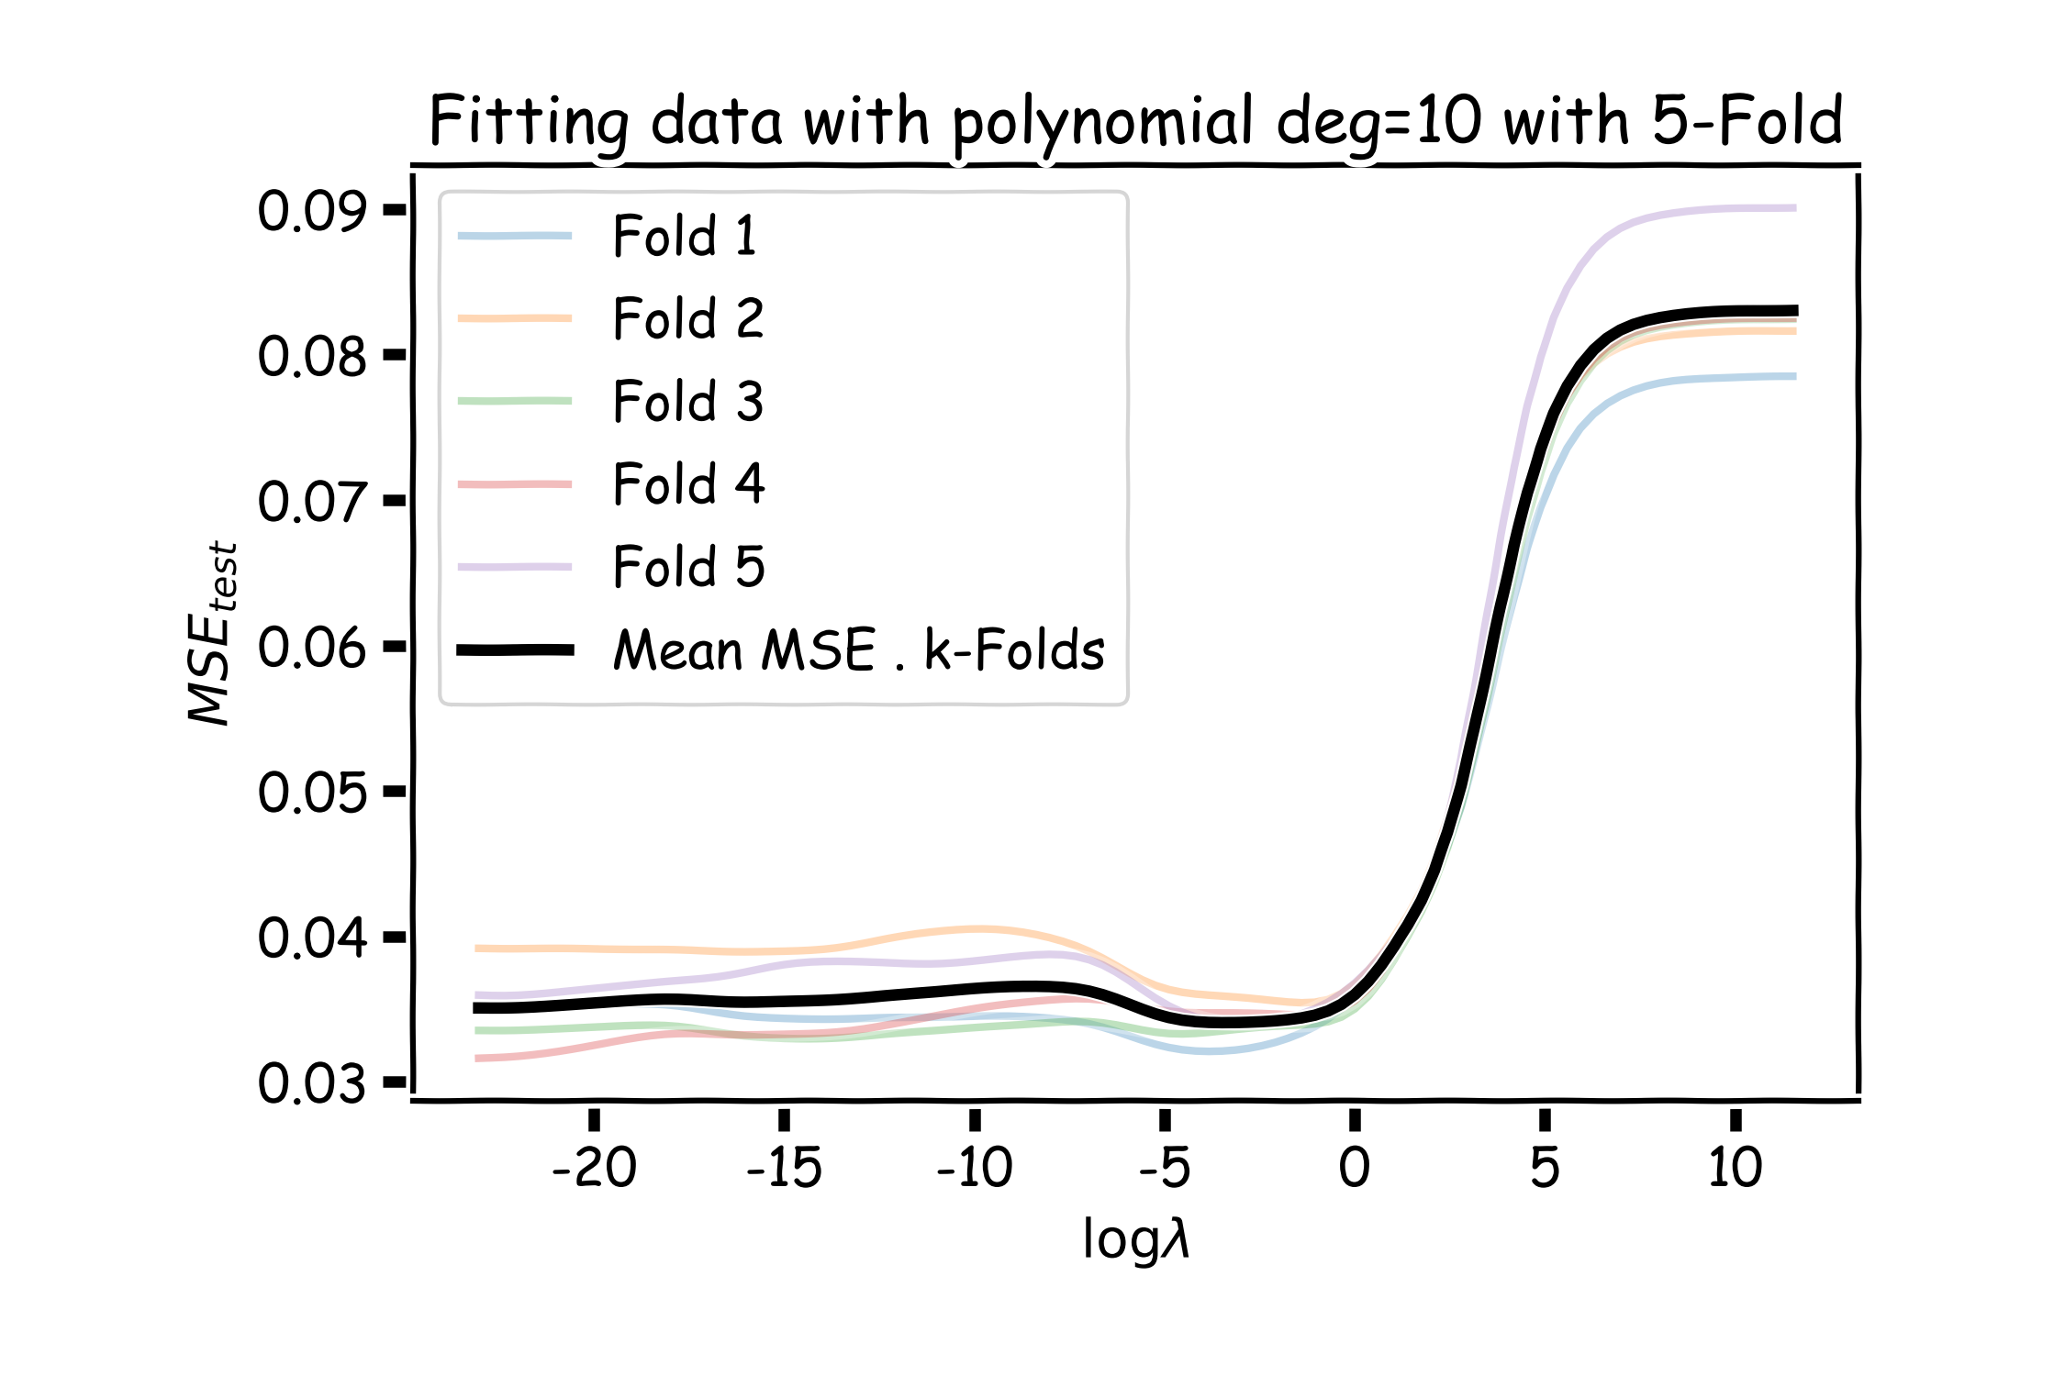
Ridge regularization with validation only: step by step
val

Slide 29
Variable Selection as Regularization
Since LASSO regression tend to produce zero estimates for a number of model parameters - we say that LASSO solutions are sparse - we consider LASSO to be a method for variable selection.
Many prefer using LASSO for variable selection (as well as for suppressing extreme parameter values) rather than stepwise selection, as LASSO avoids the statistic problems that arises in stepwise selection.
Question: What are the pros and cons of the two approaches?

Slide 30
Quiz time: Lecture 8

